Slide 1
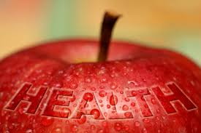
The Knowledge, Skills, and Preferences
By Tory Pelot

Slide 2
Intrapersonal Standpoint
From an Intrapersonal point of view, the knowledge, skills and preferences related to health promotion can greatly affect an individuals lifestyle choices.
The reason that a person has developed this certain set of knowledge, skills, and preferences can be traced from many different points in their life that have lead them to create a lifestyle that is healthy or somewhat unhealthy.

Slide 3
Knowledge
Unfortunately, many in the world are lacking the knowledge that can help them lead a healthier lifestyle.
Although this fact is very unfortunate, programs in schools, communities, media, and other outlets are creating a dialogue to help spread the word about health promotion and the easy ways to augment your lifestyle in simple ways.

Slide 4
Veggie Mobile Study
In an experimental study, researchers followed the change in residents of a low income neighborhood that were exposed to less expensive vegetables that were also conveniently brought to them in what the experiment called “The Veggie Mobile”. The purpose was to identify if there was a change in the consumption of fresh vegetables in low income elderly neighborhoods if the veggies were more available and less expensive. The result of the experiment found that the vegetable consumption increased by .37 servings per day.

Slide 5
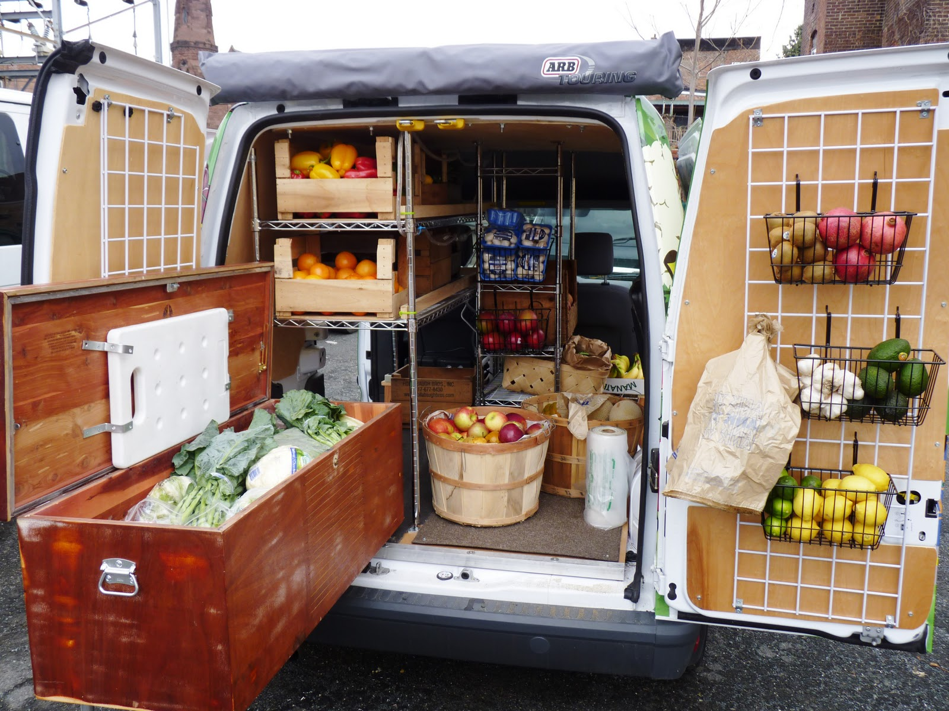
This experiment is a true testament to how the exposure of these foods that would otherwise escape the elderly population, helping them gain knowledge of the many ways fruits and vegetables can create a healthier lifestyle.
If this veggie mobile experiment had not been implemented in the low income elderly neighborhood, these citizens would not have gained the knowledge of how to purchase, prepare, and integrate necessary food groups into their daily meals.

Slide 6
Farm Stand Study
In another study taking place in a low income area, 2 farm stands were placed in 2 communities 1 day a week for 12 weeks. The objective was to find if the opportunity and knowledge of eating healthy and creating a more healthful life were exposed, would the participants recognize the more available healthy options by using the farm markets? Would the families behaviors change because of this new knowledge? Finally, would the importance of eating better and habits of the participants change?

Slide 7
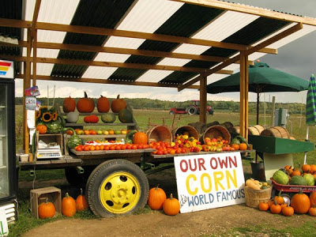
Farm Stand Study
As a result, it was found that the participants in the study showed significant increases in fruit and vegetable consumption because of the knowledge gained and the availability of the farm stand. Similarly to the other study with the veggie mobile, the participants showed significant increases in daily consumption because of the knowledge gained through the farm stands as well as the availability of fresh fruits and vegetables.

Slide 8
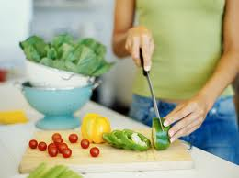
Skills
Because there is a lack of knowledge, there is inevitably a lack of skills associated with health promotion from an intrapersonal standpoint.
When people do not have the basic knowledge in regards to health promotion, they are obviously lacking the skills to lead a healthier life.
These particular skills include specific cooking and preparation of food to tailor their lives, understanding the proper exercising that is most beneficial to them, as well as the best ways to stay spiritually and mentally fit.

Slide 9
Preferences
The preferences of an individual are important in the choices they make in relation to their health promotion. Although a person realizes they must be in good health, they also have a particular routine or items they prefer, whether they be healthy or not.
These preferences originate mostly from the way in which a person was raised, the culture they were surrounded with, and the people that played influential roles in their lives.

Slide 10
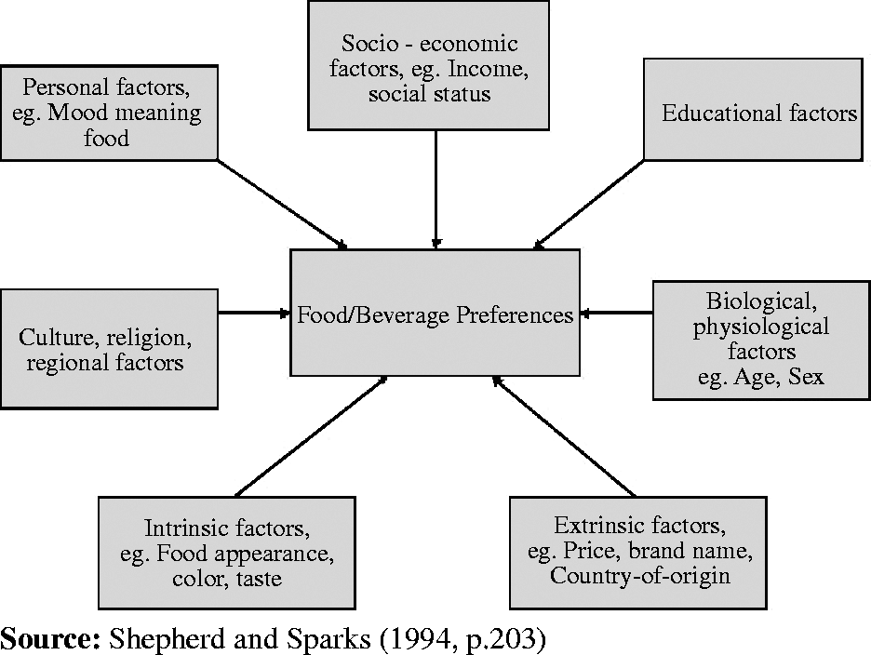
As seen in the graph below, food preferences are determined by a multitude of factors.
Each of these factors are directly related to the knowledge, skills, and preferences of indiviuals as it relates to health promotion from an intrapersonal perspective.

Slide 11
Conclusion
In conclusion, the knowledge, skills, and preferences of a person greatly affects their health and what factors individuals believe to be be important in relation to their intrapersonal relationship with health and health promotion. Although the knowledge, skills, and preferences differ from person to person, it is pertinent that knowledge of proper health choices are spread, skills needed to create a healthy lifestyle are practiced, and preferences of the people are recognized to help modify choices or moderation tools are put in place to help people understand that healthy lifestyle is crucial for all.

Slide 12
References
Abusabha R, Namjoshi D, Klein A. Increasing access and affordability of produce improves perceived consumption of vegetables in low- income seniors. J Am Diet Assoc. 2011 Oct;111(10):1549-55
Evans AE, Jennings R, Smiley AW,Medina JL, Sharma SV, Rutledge R, Stigler MH, Hoelscher DM.Introduction of farm stands in low-income communities increases fruit and vegetable among residents. Health Place. 2012 Sep;18(5):1137-43
Xiaoling Hu, Leeva Li, Charlene Xie, Jun Zhou, (2008) "The effects of country-of-origin on Chinese consumers' wine purchasing behaviour", Journal of Technology Management in China, Vol. 3 Iss: 3, pp.292 – 306
-(chart on slide 10)

