Slide 1
Food Pricing
By Tory Pelot

Slide 2
Rising food prices over the last several decades have contributed to an increase in obesity as well as more prevalent health issues world wide. The issue prices has negatively impacted the world dramatically, completely disrupting the promotion of a healthy lifestyle for all.

Slide 3
Quality vs. Quantity
The relationship between price and quality of food comes as no surprise, but at this point in time with the economy causing financial issues for the country, quality of food available at a reasonable price is scarce.
Fresher, less processed foods are far more expensive then prepackaged or genetically modified products.
According to the United States Bureau of Labor Statistics as of April 26^{th,} 2012, 10.5% of families in the United States have one person in their family who is unemployed. With numbers such as these, Americans are not necessarily as worried as they would normally be about health, but more concerned about if they are able to feed their children dinner.

Slide 4
Quality
Recently, I took a trip to the local grocery store to find the difference in organic and non organic prices for milk.
To put things into perspective:
A half gallon of Organic Milk is $4.23
Gallon of Non-Organic Milk is $2.65

Slide 5
When parents are concerned about whether they can feed their children, organic and non-organic labels begin to become less important as long as their family is drinking milk. The drastic difference shows the outrageous food price increases for less quantity but higher quality and less quality but more quantity. These prices make sense normally, but when the idea of health promotion begins to come to the surface, it is unfortunate that Americans are forced to cut corners in regards to their health because they are unable to afford food that could help them and their families lead healthier lifestyles.

Slide 6
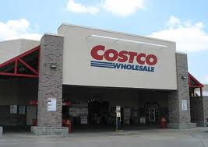
Quantity
In regards to quantity, at times it is easier to purchase large quantities of food for lower price at a wholesale market.
For example, at Costco bulk items are less expensive in the long run. Unfortunately, when purchased in bulk, quality of items becomes questionable.
This constant back and forth issue is concerning to the battle against promoting a healthier lifestyle.

Slide 7
Price of Unhealthier Food
If a family of 4 is able to eat at McDonald’s for, at the very least, around $12, how could this not seem appealing to a struggling family?
Food is readily available with no preparation time or need to spend money on more expensive products such as vegetables or meat.
Since the affordability of healthful foods have become an issue for American’s as well as the rest of the world, it has never been more important to recognize the need for food prices to change and health promotion to be brought to the forefront.

Slide 8
Cash- Back Rebate Program for Healthy Food Purchases in South Africa
In a recent study done by the American Journal of Preventative Medicine, it describes The HealthyFood program that took place in South Africa. This program provides a cash-back rebate opportunity in 400 designated grocery stores in the provinces of South America between 2009 to 2012. Of the 170,000 households that were scanned and were eligible for the rebate when buying healthy foods. The rebates that were applicable to the credit card holders who used the card for their transactions were given rebates up to 25%.

Slide 9
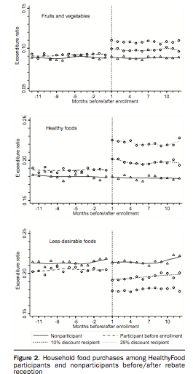
As a result of these rebate opportunities, there was a 6% increase in healthy food purchased and a decrease of less healthful foods by 5.7%. As seen in the graphs the right, there were dramatic increases in more healthful foods when the rebates were made available by the credit card company.

Slide 10
Conclusion
The high cost of food is becoming an increasing problem amongst the country because of the struggling economy. Since 1 in 5 children do not know where their next meal is coming from, sometimes it does not matter how healthy they are eating, but just that they are eating. Although this is an understandable problem, the high food cost must be taken more seriously because of the lasting and dramatic effects it will have on our health and practices of health promotion.

Slide 11
References
United States Department of Labor. Employment Characteristics of Families Summary. April 26, 2013. http://www.bls.gov/news.release/famee.nr0.htm
Roland Sturm, PhD, Ruopeng An, MPP, MPhil, Darren Segal, BSc, Deepak Patel, MD, Mphil. A Cash- Back Rebate Program for Healthy Fodd Purchases in South Africa. (Am J Prev Med 2013;xx© 2013 American Journal of Preventive Medicine

